Slide 2
BSAX66 Better together: How Microsoft Dynamics AX leverages SQL Azure and the latest Microsoft data platform
Sunil Agarwal
Michael Gall
Milinda Vitharana

Slide 3
AGENDA
Topology in the cloud or on premise using SQL Server 2016
Dynamic scaling of server in the cloud
Multiple read-only databases to distribute the load
One database for OLTP and Analytics workloads
In-memory OLTP for highly performant operations
Dynamics AX Entity store and scenarios
Cortana Analytics suite integration

Slide 4
TOPOLOGY IN CLOUD OR ON-PREMISE

Slide 5
Dynamics AX Platform
Visual Studio 2015 IDE
Tools
Windows
Universal App
(w/EMS MAM)
iOS
Android
HTML5
Client
Dynamics Integrator
(Azure BizTalk Services)
Dynamics Life Cycle Services
Workspaces
App Suite
App Foundation
App Platform
ODataV4
AX
App
Telemetry Enabled
Azure Compute
Power BI
Cortana Analytics
SSRS
Data
Azure SQL
(w/Operational Analytics)
Azure Blob
DocDB
Azure AD
Identity

Slide 6

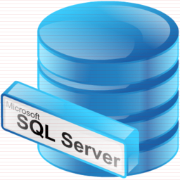
SQL Server in Dynamics AX topologies
Feature parity in SQL Azure DB and SQL Server 2016 enables deployments in cloud and on premise
AX
AX
AX
AX One-Box topology
SQL Server 2016 (CTP3)
AX Cloud topology
SQL Azure DB
AX On-premise (future)
SQL Server 2016

Slide 7
DYNAMIC SCALING

Slide 8
SQL Database Service Tiers
Basic
Standard
Premium
Intended Use
Light transactional workloads
Go-to option for most business applications
High throughput and business-critical databases
Workload Elasticity
Isolated databases and elastic database pools
Performance
•
••
•••
Business Continuity
•
••
•••
Programming Surface
Fully compatible with SQL Server 2016 databases
Availability
99.99%*

Slide 9
Predictable performance
Isolated databases are allocated isolated resources
Scale up/down
Databases remain online while scaling
Hourly billing
P11
P6
P4
P2
P1
S3
S2
S0
S1
B
5
10
20
50
100
125
250
500
1000
1750
DTUs

Slide 10
Elastic database pools
Share resources dynamically among databases on the same server/pool
Customer-managed over-provisioning makes pools cost-effective for unpredictable, sporadic workloads
Well-matched to many database-per-tenant SaaS workloads
Basic, Standard, and Premium tiers
Databases can burst to the same level as isolated DBs in the same tier
Pool size is scaled to support aggregate workload
Hourly billing for the pool based on pool size and DB count
Max per-database burst level
eDTUs
200
400
800
1200

Slide 11
MULTIPLE READ-ONLY DBs

Slide 12
Dynamics AX Data
Read/write workloads
Read only workloads
Analytics workloads
Sales Order entry, Sales confirmation, Print Invoices
Read-only workloads: Charts, KPIs, Tiles, Operational Reports
Predictions,
Near real-time Power BI
Real Time
Real Time
Near Real-time
Seconds
Minutes
Primary DB
Secondary DB
Entity Store

Slide 13
Read only secondary (ROS) DB
Available in production environments
One or more ROS DBs provisioned based on volume and load
Selected workloads routed by AOS to ROS
Workload patterns determine whether they can be run on ROS. Developer doesn’t choose
Some (limited) configuration options
Ex. Tile cache can be optimized by administrator where required
Exact copy, Seconds late…
Data in primary DB is reflected in secondary within seconds

Slide 14
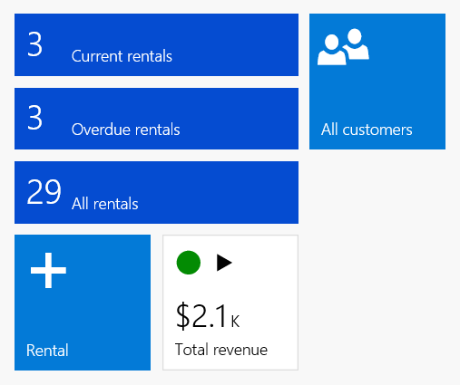

Multiple Read-only Secondary databases
Always-ON
Read/write
Read
AOS
Client

Slide 15
REAL TIME OPERATIONAL ANALYTICS

Slide 16

Minimizing Data Latency for Analytics
Select ProduceName, ExpiryDate, Quantity, sum (sales)
From <transactions>
Where ProduceType =‘perishables’
Group By ProduceName, ExpiryDate
Insert into <transactions>
values (‘<upc-code>, ‘flowers’, $20.00)
BI and analytics
Benefits
No Data Latency
No ETL
No Separate DW
Challenges
Minimizing Impact on OLTP workload
Delivering Performant Analytics
This is Real-Time Operational Analytics
Presentation Layer
IIS Server
Dashboards
Reporting
Application Tier
SQL Server
Analysis Server
SQL Server 2016
Add columnstore index
Database

Slide 17
Real-time Analytics
Nonclustered Columnstore Index (NCCI)
Btree Index
Relational Table (disk-based)
(Clustered Index/Heap)
delta
delta
Nonclustered columnstore index (NCCI)

Slide 18
Real-time Analytics: Minimizing Columnstore overhead
Real-time workload
AlwaysOn Availability Group
Analytics workload
Secondary Replica
Insert into <transactions>
values (‘<upc-code>, ‘flowers’, $20.00)
Primary
Replica
Secondary
Replica
Select ProduceName, ExpiryDate, Quantity, sum (sales)
From <transactions>
Where ProduceType =‘perishables’
Group By ProduceName, ExpiryDate
Secondary
Replica
Key Points
Mission Critical Real-time Workloads typically configured for High Availability using AlwaysOn Availability Groups
You can offload analytics to readable secondary replica

Slide 19
DEMO: How AX leverages SQL Server Operational Analytics

Slide 20
FUTURE: SECURE DATA ON THE MOVE AND AT-REST

Slide 21
Always Encrypted Help protect data at rest and in motion, on-premises & cloud
Apps
Trusted
SQL Server
SELECT Name FROM Patients WHERE SSN=@SSN
Client side
@SSN=0x7ff654ae6d
SELECT Name FROM Patients WHERE SSN=@SSN
Query
Enhanced ADO.NET
Library
@SSN='198-33-0987'
Result Set
Result Set
Column
Master Key
Column Encryption Key
Name
Name
Jim Gray
ciphertext
dbo.Patients
dbo.Patients
Jim Gray
dbo.Patients
Name
SSN
Country
Name
SSN
Country
Name
SSN
Country
Jane Doe
1x7fg655se2e
USA
Jane Doe
243-24-9812
USA
Jane Doe
1x7fg655se2e
USA
Jim Gray
0x7ff654ae6d
USA
Jim Gray
198-33-0987
USA
Jim Gray
0x7ff654ae6d
USA
John Smith
0y8fj754ea2c
USA
John Smith
123-82-1095
USA
John Smith
0y8fj754ea2c
USA
Mission critical performance

Slide 22
FUTURE: IN-MEMORY OLTP

Slide 23
Hardware Trends
Moore’s Law on total CPU processing power holds but in parallel processing…
New CPU won’t run a short transaction much faster
CPU clock rate stalled…
Because processors would melt…
Meanwhile RAM cost continues to drop

Slide 24
In-Memory OLTP – Architectural Pillars
Customer Benefits
High performance data operations
Efficient business-logic processing
Frictionless scale-up
Hybrid engine and integrated experience
Architectural Pillars
Main-Memory Optimized
T-SQL Compiled to Machine Code
High Concurrency
SQL Server Integration
Optimized for in-memory data
Indexes (hash and range) exist only in memory
No buffer pool, B-trees
Stream-based storage
T-SQL compiled to machine code via C code generator
Invoking a procedure is just a DLL entry-point
Aggressive optimizations @ compile-time
Multi-version optimistic concurrency control with full ACID support
Core engine uses lock-free algorithms
No lock manager, latches or spinlocks
Same manageability, administration & development experience
Integrated queries & transactions
Integrated HA and backup/restore
Drivers
Hardware trends
Business
Steadily declining memory price, NVRAM
Stalling CPU clock rate
Many-core processors
TCO

Slide 25


SQL In-memory engine
Faster Transactions
IN-MEMORY OLTP
Faster Queries
IN-MEMORY DW
Up to 30x faster transaction processing with In-Memory OLTP
Over 100x query speed and significant data compression with
In-Memory ColumnStore

Slide 26
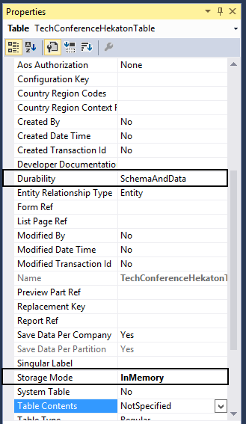
How AX7 uses In-Memory OLTP
Mark the table as Storage Mode = InMemory
Set Durability:
SchemaAndData: Data can be recreated after crash (from transaction log)
Schema: Data is lost after crash
System administrator has to accept the setup

Slide 27
FUTURE: DYNAMICS AX ENTITY STORE

Slide 28
Dynamics AX Data
Read/write workloads
Read only workloads
Analytics workloads
Sales Order entry, Sales confirmation, Print Invoices
Read-only workloads: Charts, KPIs, Tiles, Operational Reports
Predictions,
Near real-time Power BI
Real Time
Real Time
Near Real-time
Seconds
Minutes
Primary DB
Secondary DB
Entity Store

Slide 29
Entity Store – key scenarios
High volume, Near real-time Power BI reporting
De-normalized schema, CCI to enable faster query responses, Incremental update from AX, Direct Query Power BI models
Intelligent business processes with Cortana Analytics suite
Stage data for Azure Data Factory pipelines, Consume in Azure Machine Learning
IoT, external data integration
Staging in Azure Data Lake and Azure Data warehouse

Slide 30
Entity store – key tenants
Designed for analytical scenarios
Azure DB entity store included in AX license
AX manages deployment and refresh
Optionally, customer can stage data in Azure DB, DL and DW for read-write scenarios
Coming soon to AX2012 R3

Slide 31
FUTURE: CORTANA ANALYTICS SUITE INTEGRATION

Slide 32
From data to decisions and actions
Data
Recommendations
What should I do?
Decision
Action
Decision automation
Decision support
Predictions
What will happen?
Interactive dashboards
Why did it happen?
Static reports
What happened?
Manual process
Value

Slide 33







Cortana Analytics Suite Transform data into intelligent action
Information Management
Big Data Stores
Machine Learning and Analytics
Dashboards and Visualizations
Business apps
Power BI
Azure
Data Factory
Azure
Machine Learning
Personal Digital Assistant
Azure
Data Lake store
Cortana
Azure Data Lake analytics service
People
Custom apps
Azure
Data Catalog
Perceptual Intelligence
Azure HDInsight
(Hadoop and Spark)
Face, vision
Azure
SQL Data Warehouse
Speech, text
Azure
Event Hub
Azure
Stream Analytics
Business Scenarios
Sensors and devices
Recommendations,
customer churn,
forecasting, etc.
Automated Systems
Data
Intelligence
Action

Slide 34
From data to decisions and actions
Data
Recommendations
What should I do?
Decision
Action
Decision automation
+
Decision support
+
+
Predictions
What might happen?
+
Interactive dashboards
Why did it happen?
Static reports
What happened?
Manual process
Value

Slide 35




Example: Integrating AX Retail with Azure ML Recommender
Azure
Azure Resource Group
AX Internal
SQL DB
Retail Recommender
Data Factory
Entity Store
Extract Data
From AX DW
Unique-ify Cash
POS Transactions
Save Results to
Temporary Blob
Call Recommender
API to Create and
Build Model
Recommender
Client
Azure ML Product
Recommender APIs
Intelligent Application
Registry

Slide 36
AX + CAS go-to market approaches
Intelligent Business processes
Attached Business apps
Customer buys AX
Solution uses AX data + CA services
Solution built on AX platform
Consumes CA services enabled by AX platform
Provisioned with LCS
Customer buys CAS
Customer pays for CAS consumption
AX data + other data
Solution built using CAS tools
Stand-alone apps
AX powered by CAS
CAS Solutions

Slide 37
Summary
SQL capability | How AX7 leverages … | Benefit to AX7
SQL server 2016, Cloud or on-prem | AX7 on-prem and Developer instances on SQL 2016 AX7 on public cloud uses Azure DB | One AX7 platform – two deployment options
Dynamic scaling of DB (Scaling DB, MALMO) |  | Increase the DB size as your business grows (and shrinks)
Multiple read-only DBs | Data access stack able to address multiple read-only DBs | Spread the load into multiple DB instances
Operational Analytics | Aggregate measurements NCCI table indexes | Near real-time analytics on the same DB
In-memory OLTP | Set table properties | Leverage quick table access for tables satisfying constraints.

